Slide 1
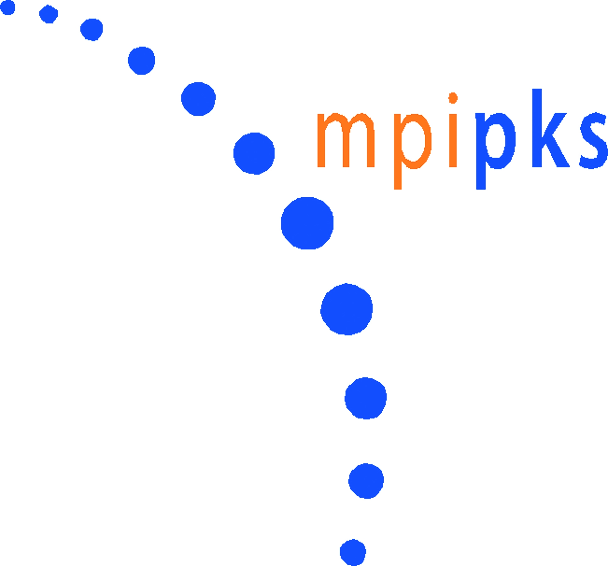
We offer fully funded PhD positions in:
Theoretical and Computational Physics
Physical and Quantum Chemistry
Materials Science
Scientific Computing
!!! Application Deadlines !!!
April 30th and October 31st
For more information visit
http://www.imprs-dynamics.mpg.de

